Slide 1
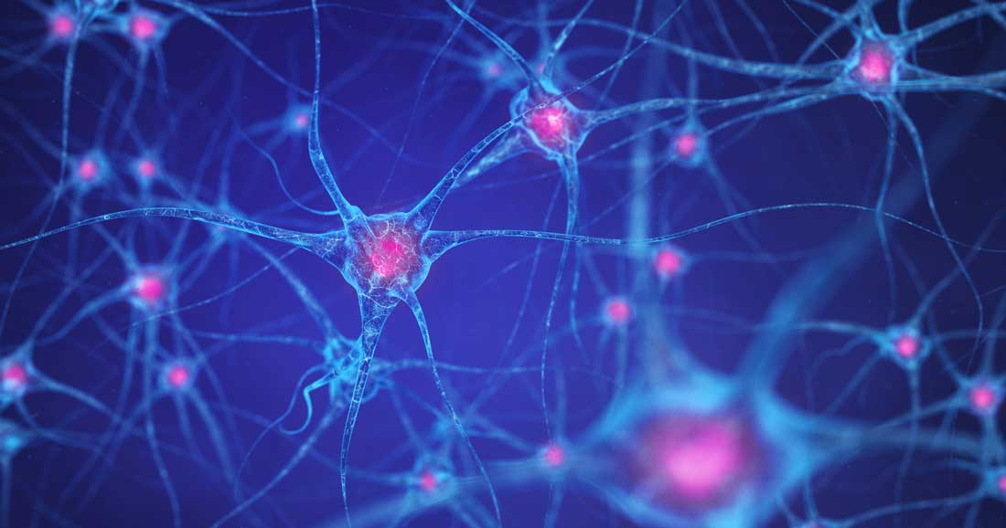
WHAT INFLAMMASOMES TELL US ABOUT MULTIPLE SCLEROSIS
NİSA HOCAOĞLU
PROF DR ESRA GÜRSOY

Slide 2
MULTIPLE SCLEROSIS
IMMUNE MEDIATED AND CHRONIC CNS DISEASE
THE MOST COMMON NEUROLOGICAL DISEASE CAUSING DISABILITY IN YOUNG ADULTS

Slide 3
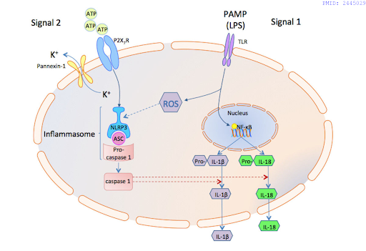
INFLAMMASOMES
Inflammasomes are protein complexes and contain;
A protein that senses stimulation (NLRP3, AIM2, etc.)
An adaptor molecule (ASC/PYCARD)
A catalytic protein (pro-caspase)
When the inflammasome complex is activated, caspase1 is activated, releasing interleukins and inflammation occurs.

Slide 4
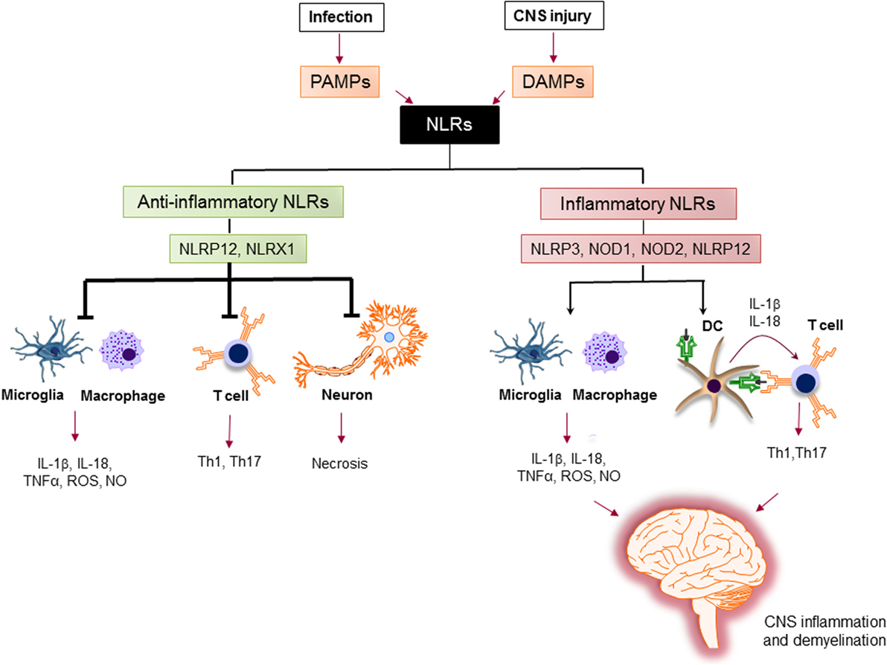
NLRX1 is a mitochondria-located innate immune sensor that inhibits major proinflammatory pathways
Gharagozloo M, Front Immunol. 2018 Feb

Slide 5
WHAT HAS BEEN FOUND IN RESEARCHES SO FAR ?
According to studies, different components of inflammasomes and caspase 1 are effective in the experimental animal model of MS disease (EAE) and the onset and development of MS disease.
NLRP3 inflammasome and IL-1 beta have been shown to play a role in the response to IFN beta therapy in patients with relapsing remitting MS.
In a study on the severity of MS disease, it was shown that low IL-18 levels and/or NLRC4 levels have positive results for patients, and that the increase in NLRP3 and IL-1 beta production is effective in the transformation of MS disease into more severe forms.(5)
Song L, Frontiers in Cellular Neuroscience. 2017
Lang Y, Mediators of Inflammation. 2018
Malhotra S, Brain. 2015
Soares JL, Multiple Sclerosis and Related Disorders. 2019

Slide 6
PURPOSE OF STUDY
Contribute to explaining the importance of inflammasomes in the pathophysiology of MS
To find a biomarker for the diagnosis of MS and also to find out whether the patient is in relapse or remitting period with this biomarker

Slide 7
METHODS
48 individuals participated in this study. MS patients categorized either they were in remission (n=29) or in relapse (n=9) period. In addition, healthy people with no MS symptoms (n=10) were included as a control grup.
The blood was drawn from patients and healthy volunteers to evaluate the gene expressions of NLRP3, NLRX1, IL-1 beta, IL-18 and PYCARD (ASC).
INCLUSION CRITERIA
RELAPSE GROUP :
Having an attack in the last 30 days No neurodegenerative disease other than MS No hypertension Not having diabetes No active infection
REMITTING GROUP :
No clinical attack in the last 3 months No neurodegenerative disease other than MS No hypertension Not having diabetes No active infection
CONTROL GROUP :
No neurodegenerative disease No hypertension Not having diabetes No active infection

Slide 8
METHODS-2
Lymphocytes were isolated from peripheral blood samples taken into heparinized blood tubes from the people who have been participated in the study and stored at -80 degrees until molecular analysis.

Slide 9
METHODS-3
PBMC ISOLATION
RNA ISOLATION
cDNA CONVERSION
RT- qPCR
GENE EXPRESSIONS OF INFLAMMASOMES

Slide 10
RESULTS
In remission and relapse group NLRP3 gene expression was found to be increased compared to the controls, but the increase was not statistically significant (p=0,940)
The gene expression of IL-1ß was found to be increased in remission group and decreased in relapse group, but these were not statistically significant (p=0,261)
In remission and relapse group IL-18 and PYCARD gene expressions were found to be decreased compared to the control group, but the decrease was not statistically significant (p=0,885 and p=0,152 respectively)

Slide 11
RESULTS-2
The difference of NLRX1 gene expressions between groups was found to be statistically significant (p=0,049). There was a decrease in NLRX1 gene expression in relapse and remission groups compared to the controls, this decrease was more pronounced in the relapse group

Slide 12
DISCUSSION
A study by Noroozi and colleagues revealed that, IFN-β 1a decreases inflammation via NLRP3, NLRC4, and AIM2 expressions, which can lead to decreased cleavage of IL-1β and IL-18.
In our study NLRP3 gene expression was found to be increased in both relapse and remission groups, although there was a decrease for IL-1β in relapse group as we don’t expect based on the literature.

Slide 13
DISCUSSION
There are also contraversial studies in the literature.In the study by Gharagozloo and friends found that PBMCs from relapsing-remitting MS (RRMS) patients express significantly higher levels of NLRX1 mRNA than healthy controls.
In our study relapse and remission group patiens had lower levels of NLRX1 than control group and the difference of NLRX1 gene expressions between groups was found to be statistically significant and this is consistent with the anti-inflammatory nature of NLRX1.
The number of studies on this subject in the literature is very few, and further studies should be conducted with more people on this subject and the results should be re-evaluated.

Slide 14
LIMITATIONS
Due to time constraints and pandemic, the number of Ms patients in the relapse group participating in our study was low.

Slide 15
CONCLUSIONS
As we know from the literature NLRX1 has anti-inflammatory effects. In the future it can also be used as a biomarker of MS relapses, but larger studies and validation of the results are needed.

Slide 16
ACKNOWLEDGMENTS
COAUTHORS
BİRSEN ELİBOL
ZEHRA CEMRE KARAKAYALI
ŞULE TERZİOĞLU
NUR DAMLA KORKMAZ

